Slide 1
Automatic Call Response
Android Application
Present by Patil Ravikumar N
College: GEC GANDHINAGAR

Slide 2
What is Automatic Call Response ?
Automatic call response is an application to answer the phone calls automatically on some specified conditions.
This application is designed for quickly responding of incoming calls by sending message or location to the caller.
User can reply with custom message and can also set the missed call limits to automatically answer the call.
The incoming call is automatically answered on some limited number of missed call and can record the voice message from the caller for free of cost.

Slide 3
Why I had developed this application?
There are lots of application in market to record the incoming calls and outgoing calls but there is no application to automatically answer the incoming call on some specified conditions.
User sometime is not able to answer the important calls at that time this application will helpful .
Sometimes we don’t want to answer the calls of unknown numbers or spams then also this application is useful
We can securely store the files which are recorded by the application

Slide 4
Technology and Tools used
Android Studio 3.0 Editor to develop the application
Java as backend
Android UI
SQLite as Database
Google MAP API for location

Slide 5
Scope and Users
This application can be used by every android user who don’t want to missed the important calls and messages.

Slide 6
How it works?
When caller calls the user and user is not available to answer the call the call will be missed.
If another call by same caller will caught then application will check for the missed call limits set by user and after that number of limits the call will be automatically answer automatically by the application and the voice message from the caller will be recorded
If user set the quick message reply then the message from the user will be sent to the caller before reaching maximum missed call limit (before automatically answered)
If user has set the location sharing option on then user’s current location will be sent to the caller along with the custom message.

Slide 7

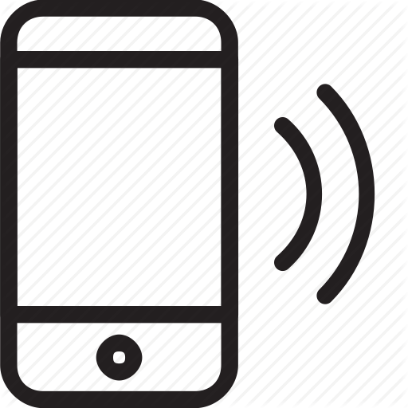

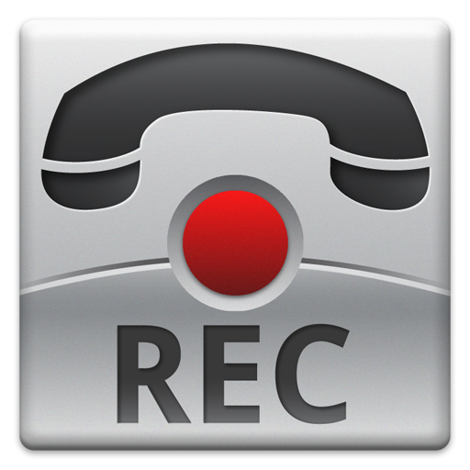





Architecture
caller
Block caller Number
Receive and record call
Incoming call
Block list contact
In special list
Send location or message
Check missed call limit
Reached Missed call limit

Slide 8
What are the features?
Custom quick message response
Location sharing
Call Recording
Secure FILES
Custom missed call limits
Special list and block list

Slide 9
Future Work
Custom voice reply
Bulk Messaging
Automatic calling from list

Slide 10
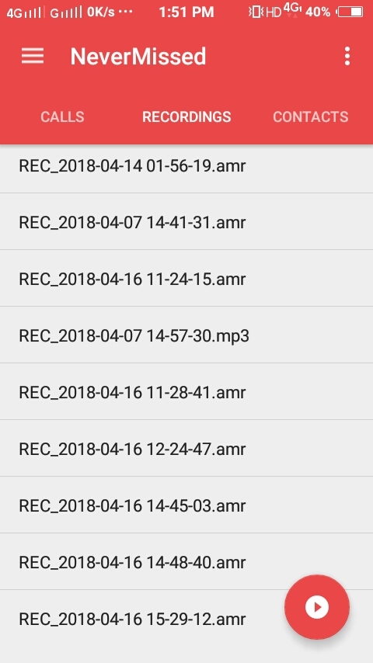
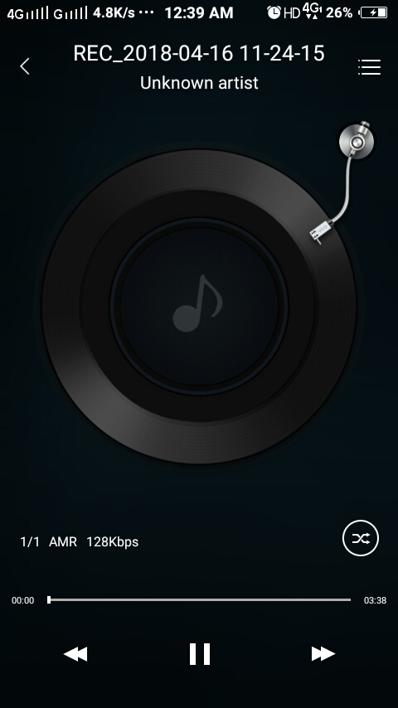
Screen Shots
Recordings Screenshots

Slide 11
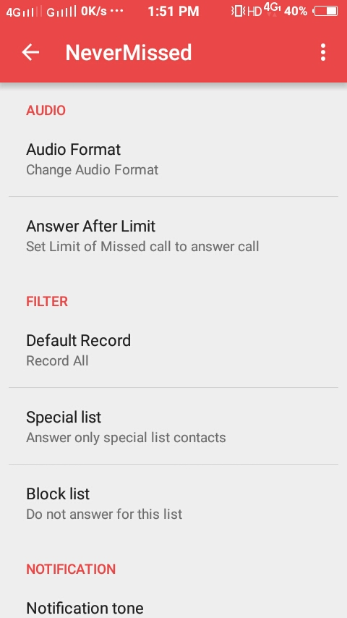
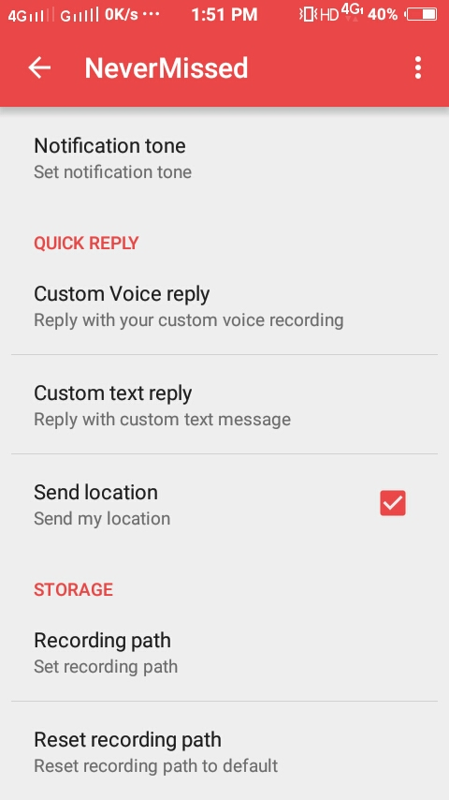

Slide 12
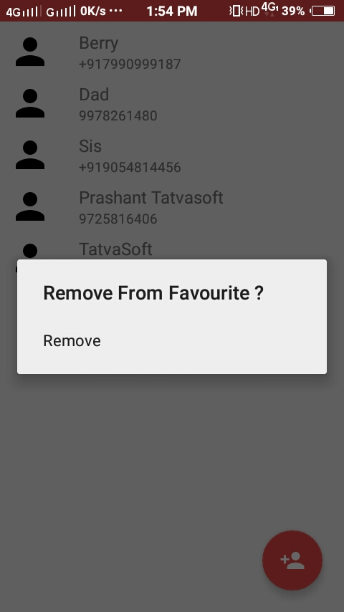
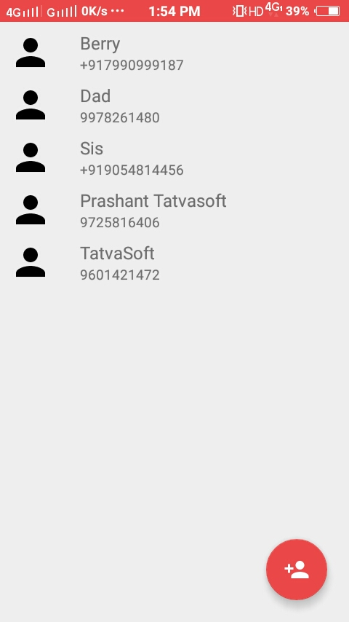

Slide 13
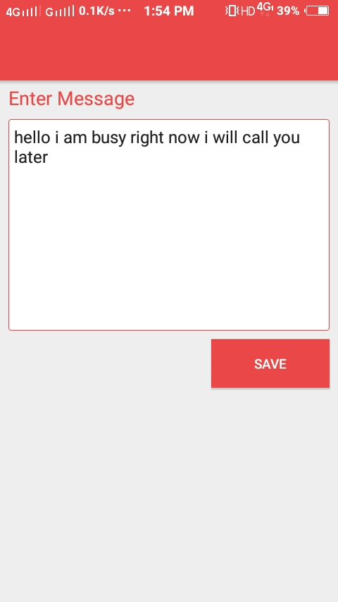
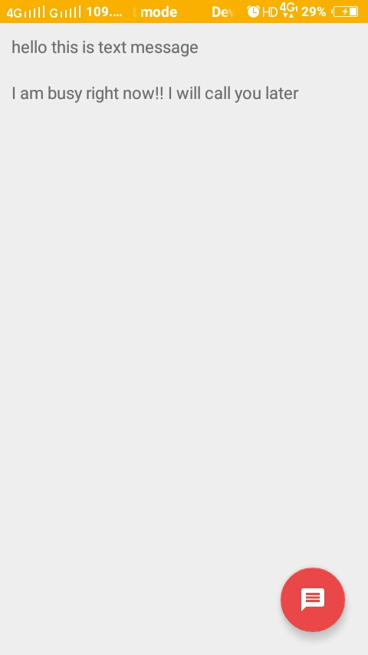

Slide 14
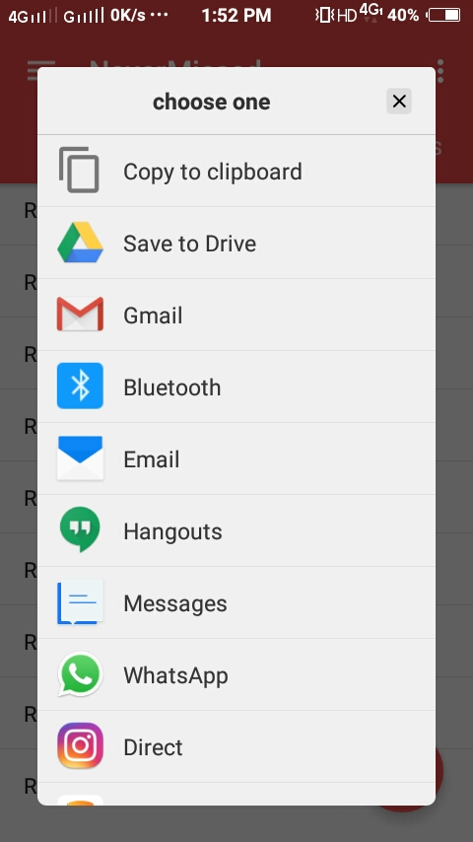
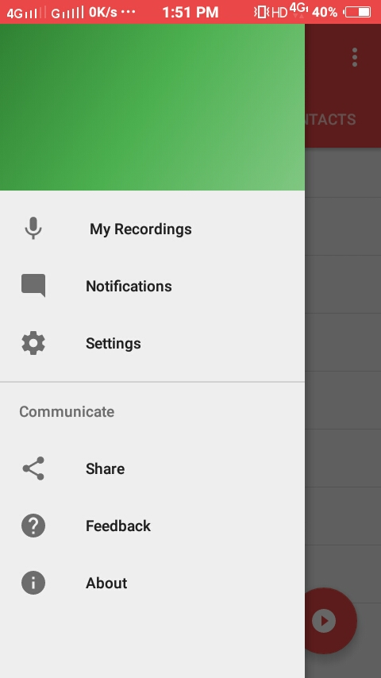

Slide 15
Limitations
Message service is costly
Predefine audio message in between call needs third party support.

Slide 16
References
Google
Stack Overflow
Android Hive
developer.android.com

Slide 17
Thank you

